Slide 1
Wi-Fi Localization
COS 463: Wireless Networks
Lecture 21
Kyle Jamieson

Slide 2
Today
Motivation of Wi-Fi based localization
Angle of Arrival (AoA) based localization
Time Difference of Arrival (TDoA) based localization

Slide 3
Today
Motivation of Wi-Fi based localization
Angle of Arrival (AoA) based localization
Time Difference of Arrival (TDoA) based localization

Slide 4
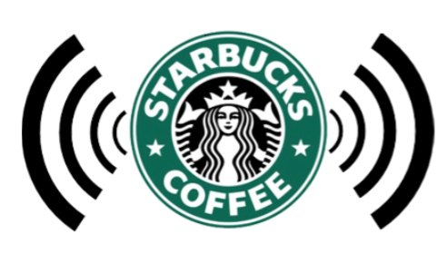

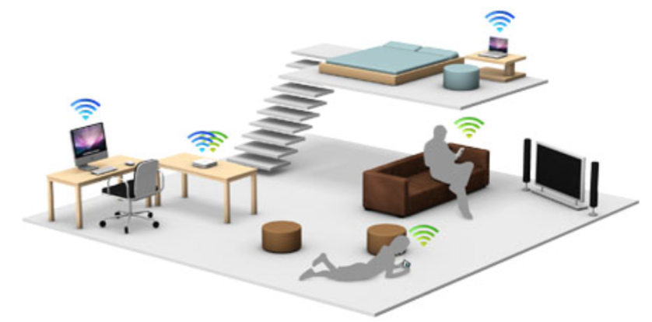
Wi-Fi is Everywhere
Homes
Public
Universities & Enterprises

Slide 5
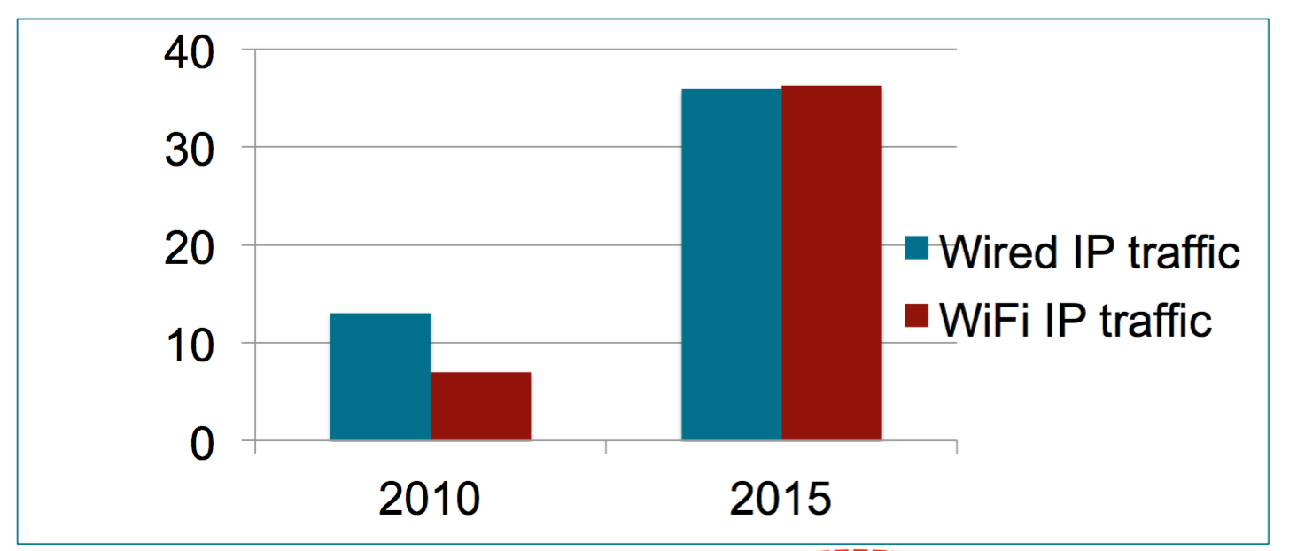
Huge Increase on Wi-Fi Traffic
Worldwide Internet Traffic (exabytes/month)
5 GB for each person on earch

Slide 6
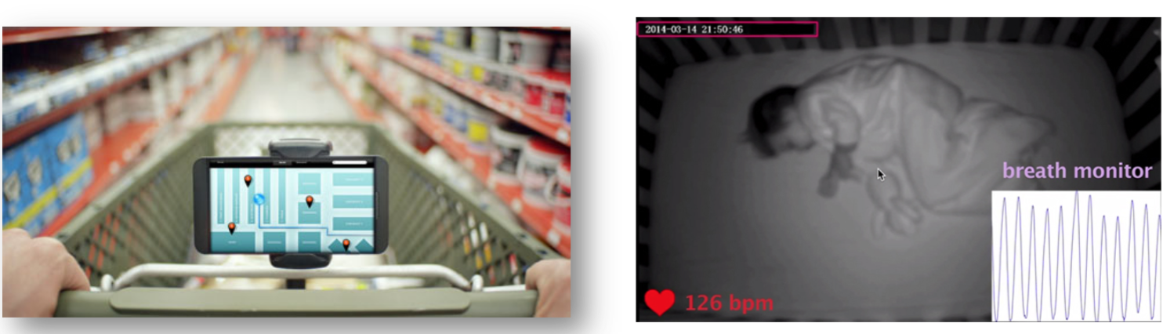
Can Wi-Fi be used for more?
Critical role in emerging applications

Slide 7
The Key Component for These Applications
Accurate Indoor Localization

Slide 8
Why Indoor Localization in Difficult
GPS does not work indoors due to blockage, multi-path etc.

Slide 9
Today
Motivation of Wi-Fi based localization
Angle of Arrival (AoA) based localization
ArrayTrack localization system (NSDI’13)
Time Difference of Arrival (TDoA) based localization

Slide 10
Today
Motivation of Wi-Fi based localization
Angle of Arrival (AoA) based localization
Time Difference of Arrival (TDoA) based localization

Slide 11

Basic theory of operation
x₁
Q
AP x₁
AP x₁
2πd/λ
λ
I
d
Mobile
Measured baseband signal at AP

Slide 12
Basic theory of operation
AP
Q
x₁
x₂
x₁
λ/2
2πd/λ
d
θ
θ
I
½λ sin θ
x₂
Mobile
In a solely line-of-sight environment, phase measurements give client’s bearing to AP θ

Slide 13
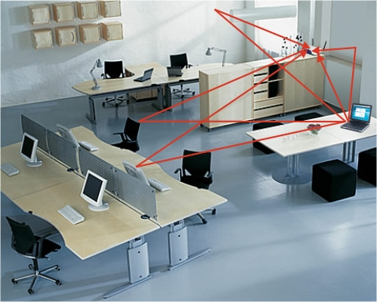
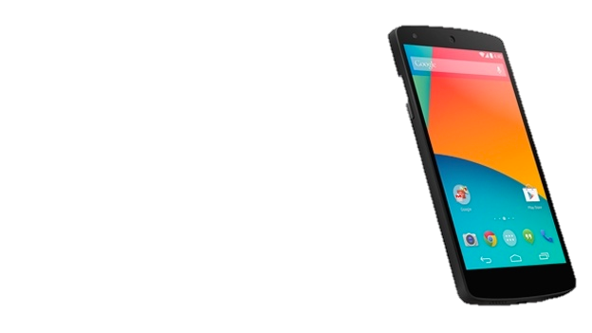
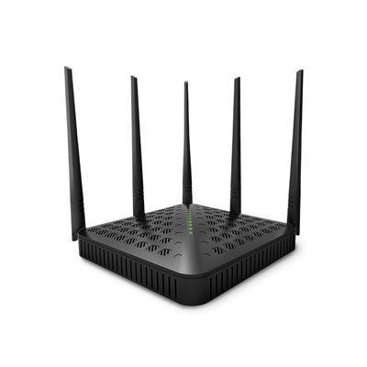

Challenges: multi-path reflections
Rich multipath reflections
Direct path attenuated
Wall
AoA spectrum
Mobile
AP
Furniture

Slide 14
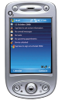
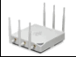
The effect of small mobile movements
Observation: on slight mobile movement, the direct path to the AP exhibits more stability than the reflection paths

Slide 15
Motion-based multi-path suppression
✗
✗
✔︎
Stable direct path bearing is identified

Slide 16
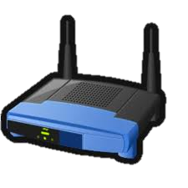
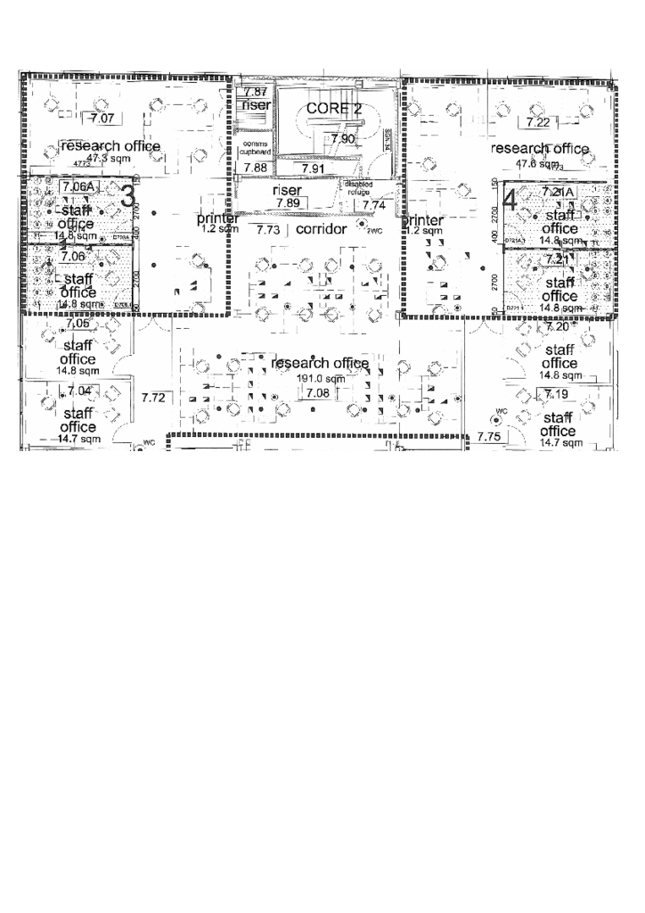
Combining the heatmap
AP 1
AP 2
Likely
Unlikely
Likelihood of being at location x:
P(x) = P₁(θ₁(x)) ∙ P₂(θ₂(x))

Slide 17
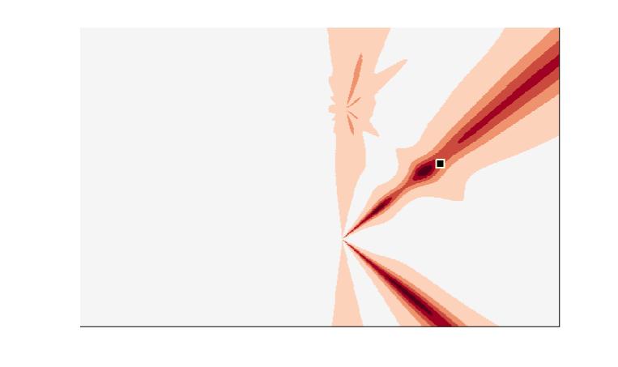
Combination cancels multipath
AP 1
Likely
Unlikely
APs’ direct paths reinforce ✔
APs’ multipath
agrees ✗
AP 2
Multipath cancels
(APs disagree) ✔

Slide 18
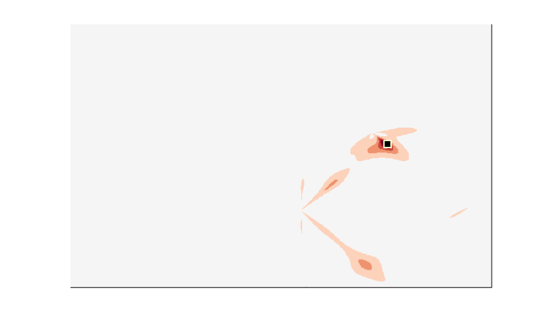
Combination cancels multipath
AP 1
Likely
Unlikely
Multipath cancels
(APs 1, 2, 3 disagree) ✔
Direct path
AP 2
AP 3

Slide 19
ArrayTrack is robust and real-time
5 -10 samples needed
0.25 us at a 40Mhz sampling rate
No need to decode the packet content
Processing at the AP side
Packet body
Preamble part

Slide 20
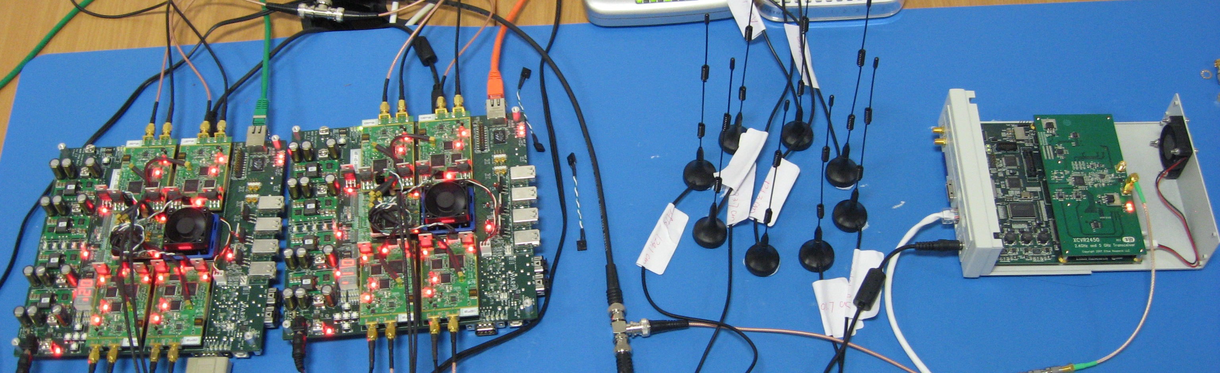
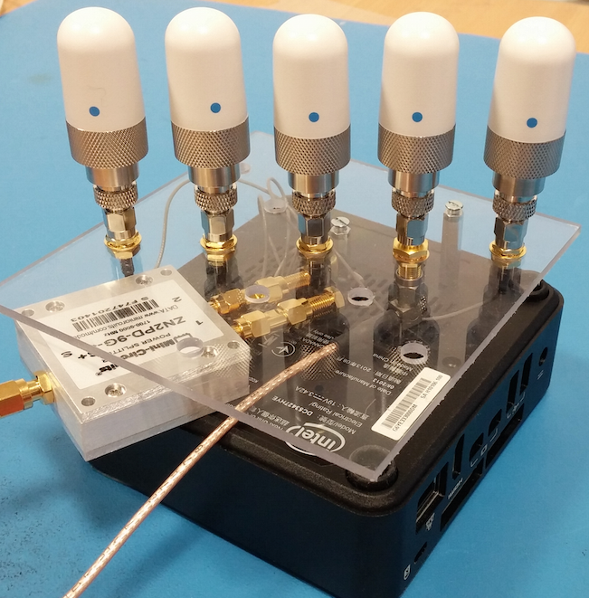
Prototypes
Software defined radios
Rice WARP v2
Maxim 2829 RF transceiver
Commodity hardware
Intel Mini PC
Intel 5300 Wi-Fi card

Slide 21
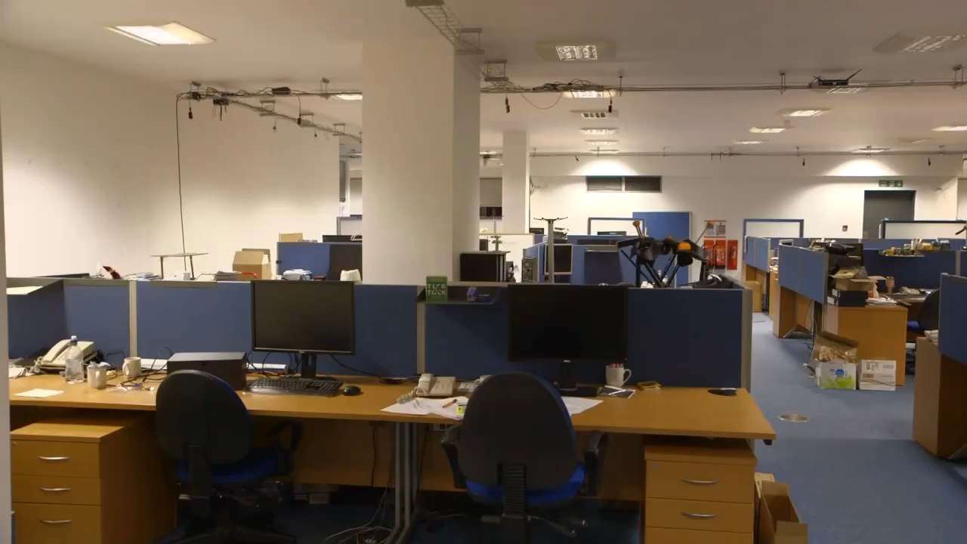
Prototype and deployment
Great thanks to Jon Gjengset for this video

Slide 22
ArrayTrack is highly accurate
Median accuracy:75 cm

Slide 23
ArrayTrack is highly accurate
Median accuracy:46 cm

Slide 24
ArrayTrack is highly accurate
Median accuracy:31 cm

Slide 25
ArrayTrack is highly accurate
Median accuracy:25 cm
Worst case:1.5 m

Slide 26
Today
Motivation of Wi-Fi based localization
Angle of Arrival (AoA) based localization
Time Difference of Arrival (TDoA) based localization
ToneTrack (Mobicom’15)

Slide 27
ToA/TDoA based localization
Not popular with Wi-Fi
Physical layer | Bandwidth | Raw resolution
802.11a/g | 20 MHz | 15 m
Physical layer | Bandwidth | Raw resolution
802.11a/g | 20 MHz | 15 m
802.11n | 40 MHz | 7.5 m
Wi-Fi bandwidth is limited
Low localization accuracy

Slide 28
Opportunities
802.11ac supports higher bandwidth
Super-resolution schemes can improve the raw resolution by 2x
Physical layer | Bandwidth | Raw resolution
802.11ac | < 160 MHz | > 1.9 m

Slide 29
Super resolution MUSIC ToA
d_{diff}
Wall
d₂
Mobile
d₁
d₂ - d₁ = d_{diff}
Super-resolution scheme improves the raw resolution by 2x
Super-resolution scheme still has a limit !

Slide 30
MUSIC’s resolution limit
Naïve: 15m resolution
(20MHz bandwidth)
MUSIC: around 8m resolution
When two paths get closer, MUSIC fails to resolve them
The two peaks merge into one eventually

Slide 31
New opportunities
802.11ac employs primary/secondary channels
avoids neighbor AP’s interference
switches channel on a per-frame basis with announcement frame
no re-association/authentication
Mobile
2 ms
Time
20 MHz
Frequency

Slide 32
Can we combine data from adjacent channels to create a larger virtual bandwidth?
Mobile
Mobile
Time
Time
?
20 MHz
60 MHz
Frequency
Naively combing data from adjacent channels does not work!

Slide 33
Another key observation
When the signals are closer than the resolution limit, the stronger peak is more accurate!
MUSIC peaks
Ground truth
ns

Slide 34
ToneTrack
Channel combination
Creates larger virtual bandwidth: higher resolution
Spectrum identification (SI)
Retrieves useful information from inaccurate spectrum
Triangle inequality (TI)
Identifies the AP with direct path 100% blocked

Slide 35
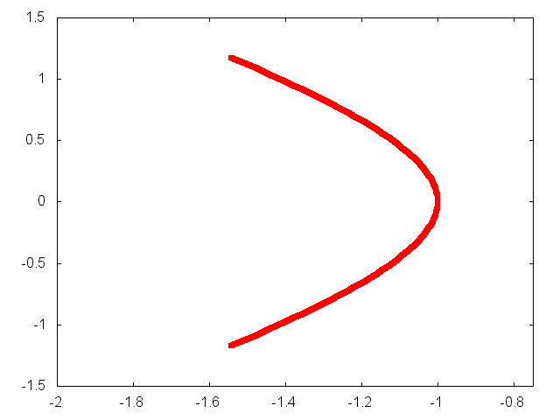

TDoA localization
AP 1
AP 1/2 →
← AP 1/3
AP 3
Mobile
AP 2
Backend server

Slide 36
Channel combination
Data received at
different time instances
different channels
t₁
Time
t₂
t₃
Challenge: a random time offset for each transmission

Slide 37
Channel combination
Remove this time offset difference:
Still not working!

Slide 38
Channel combination
Phase plot in frequency domain
Remove the time offset difference!
Sub-carrier index
Same slope

Slide 39
Channel combination
Phase plot in frequency domain
Further align the data in frequency domain!
Working now!

Slide 40
Channel combination
The effect of channel combination

Slide 41
Channel combination
The effect of channel combination
Resolution increases

Slide 42
Channel combination
The effect of channel combination
Resolution increases

Slide 43
Channel combination
When is the spectrum not accurate?
☑
☑
If the peak distance d is larger than the resolution limit d_{l}, keep the spectrum

Slide 44
Channel combination
When is the spectrum not accurate?
☑
☑
If the peak distance d is larger than the resolution limit d_{l}, keep the spectrum
If the peak distance d is smaller than d_{l,} keep the spectrum with stronger first peak
☒
☑

Slide 45
Channel combination for merged peaks
Merged towards the second peak
For a merged peak: keep the spectrum with backward skewness
Merged towards the first peak

Slide 46
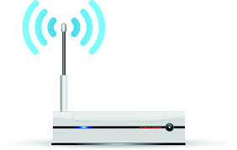

Challenge: direct path is 100% blocked
A1
A2
d₁
Mobile
d_{r}
It is unlikely to have multiple APs
with direct path all blocked!

Slide 47
Challenge: direct path is 100% blocked
A1
A2
d₁
Mobile
d_{r}

Slide 48
Multi-AP processing for LOS path blockage: triangle inequality
The LOS path difference is always smaller than the AP distance d_{c}
d_{c}
A1
A2
d₁
d₂
Mobile
d₂ – d₁ < d_{c} is always true

Slide 49
Multi-AP processing for LOS path blockage: triangle inequality
The LOS path difference is always smaller than the AP distance d_{c}
If d_{r} – d₁ > d_{c} is detected
d_{r} is NLOS path
d_{c}
A1
A2
d₁
Mobile
d_{r}

Slide 50
Multi-AP processing for LOS path blockage: outliner rejection
AP 5 localizes client to random positions while
the other APs’ estimates are clustered
AP 1
AP 2
AP 3
×
APs 1, 3, 5
×
APs 1, 2, 5
APs 1, 2, 3
×
×
APs 1, 2, 4
×
APs 2, 3, 4
×
APs 2, 3, 5
AP 5
AP 4

Slide 51
Raw MUSIC performance
Raw super-resolution median accuracy: 2.9 m

Slide 52
ToneTrack improves accuracy
ToneTrack: 1.9 m w/o channel combination
Notes:
]

Slide 53
Channel combination improves accuracy
Two channels: 1.3 m

Slide 54
Channel combination improves accuracy
Three channels: 0.9 m

